Slide 1
SDP ON PYTHON AND ITS APPLICATIONS
DEPARTMENT OF COMPUTER SCIENCE AND ENGINEERING

Slide 2
Object Oriented Programming
In all the programs we wrote till now, we have designed our program around functions i.e. blocks of statements which manipulate data. This is called the procedure-oriented way of programming.
There is another way of organising your program which is to combine data and functionality and wrap it inside something called an object. This is called the object oriented programming
Classes and objects are the two main aspects of object oriented programming.
Objects are an encapsulation of variables and functions into a single entity. Objects get their variables and functions from classes. Classes are essentially a template to create your objects.

Slide 3
Features of oops
The four major principles of object orientation are:
  Inheritance
  Polymorphism
  Data Abstraction
  Encapsulation

Slide 4
Inheritance
Inheritance is a feature of object-oriented programming. It specifies that one object acquires all the properties and behaviours of parent object.
The new class is known as derived class or child class and from which it inherits the properties is called base class or parent class.

Slide 5
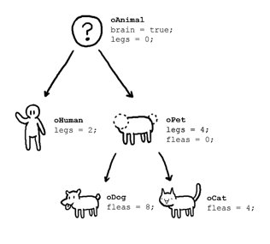

Slide 6
Polymorphism
The word polymorphism means having many forms. In simple words, we can define polymorphism as the ability of a message to be displayed in more than one form.
Real life example of polymorphism, a person at a same time can have different characteristic. Like a man at a same time is a father, a husband, a employee. So a same person posses have different behavior in different situations. This is called polymorphism.

Slide 7
Data Abstraction
Data abstraction refers to providing only essential information to the outside world and hiding their background details, i.e., to represent the needed information in program without presenting the details.
Data abstraction is a programming (and design) technique that relies on the separation of interface and implementation.

Slide 8
Encapsulation
In normal terms Encapsulation is defined as wrapping up of data and information under a single unit. In Object Oriented Programming, Encapsulation is defined as binding together the data and the functions that manipulates them.

Slide 9
How to define Python classes
To define class you need to consider following points.
Step 1) In Python, classes are defined by the "Class" keyword
class myClass():
Step 2) Inside classes, you can define functions or methods that are part of this class
  def method1 (self):
  print("Hello")
  def method2 (self,someString):
  print("Software Testing:" + someString)

Slide 10
Step 3) Everything in a class is indented, just like the code in the function, loop, if statement, etc. Anything not indented is not in the class
class myClass():
def method1 (self):
print("Hello")
def method2 (self, someString):
print("There:" + someString)

Slide 11
Step 4) To make an object of the class
  c = myClass()
Step 5) To call a method in a class
    c.method1()
    c.method2(" Testing is fun")

Slide 12
Python Inheritance Syntax
class DerivedClass(BaseClass):
body_of_derived_class

Slide 13
Python Constructors
A constructor is a class function that instantiates an object to predefined values.
It begins with a double underscore (_). It __init__() method
    class User:
    name = ""
    def __init__(self, name):
    self.name = name
    def sayHello(self):
    print("Welcome to BMSIT, " + self.name)
    User1 = User("Joe")
    User1.sayHello()

